Slide 1
“The Fembup Wiffle Ball League”
Mike Feehan
January 20, 2026

Slide 2
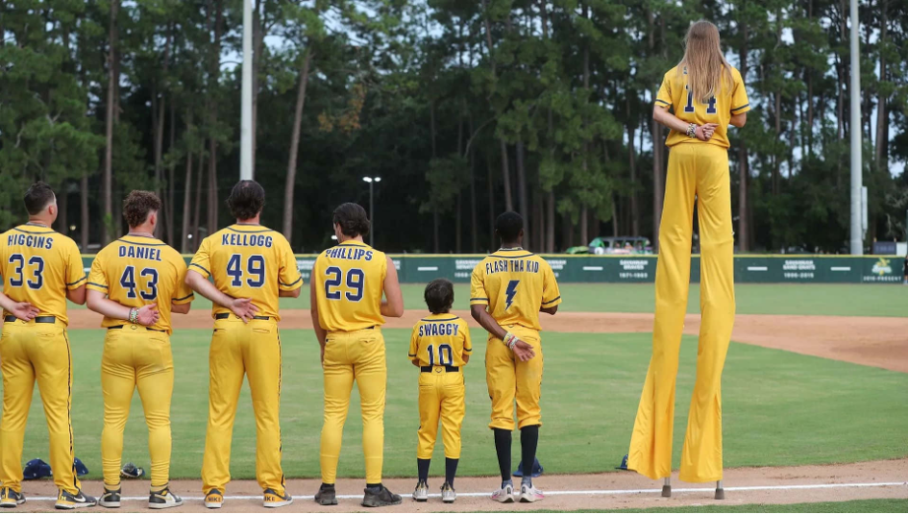

Slide 3
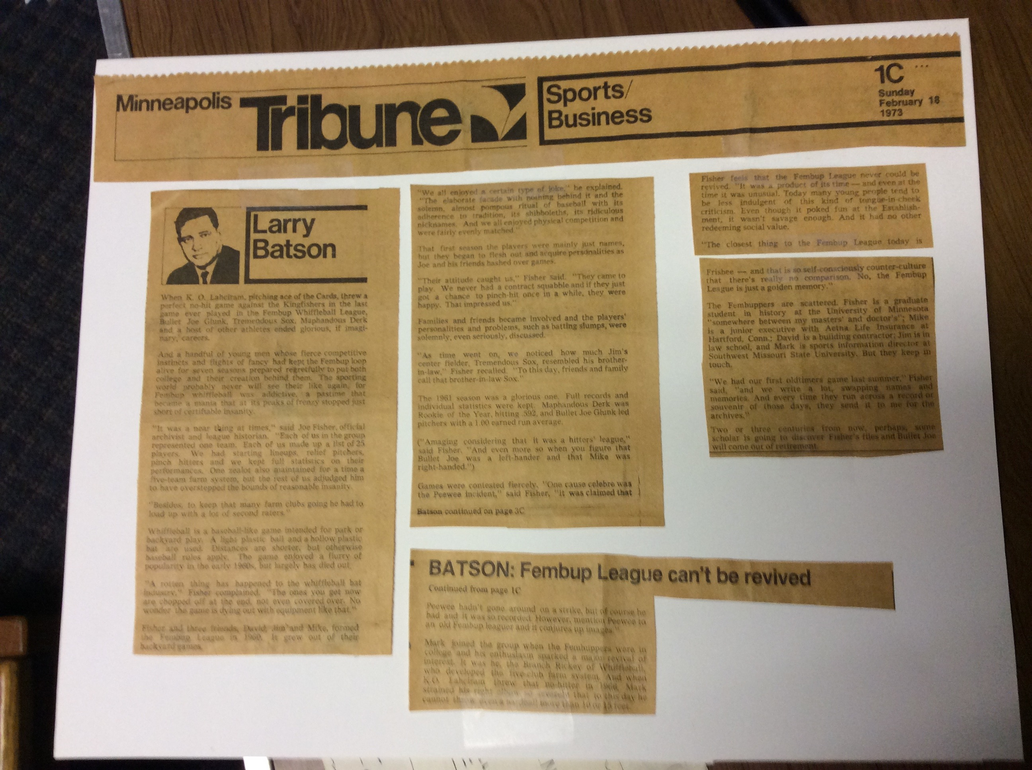

Slide 4
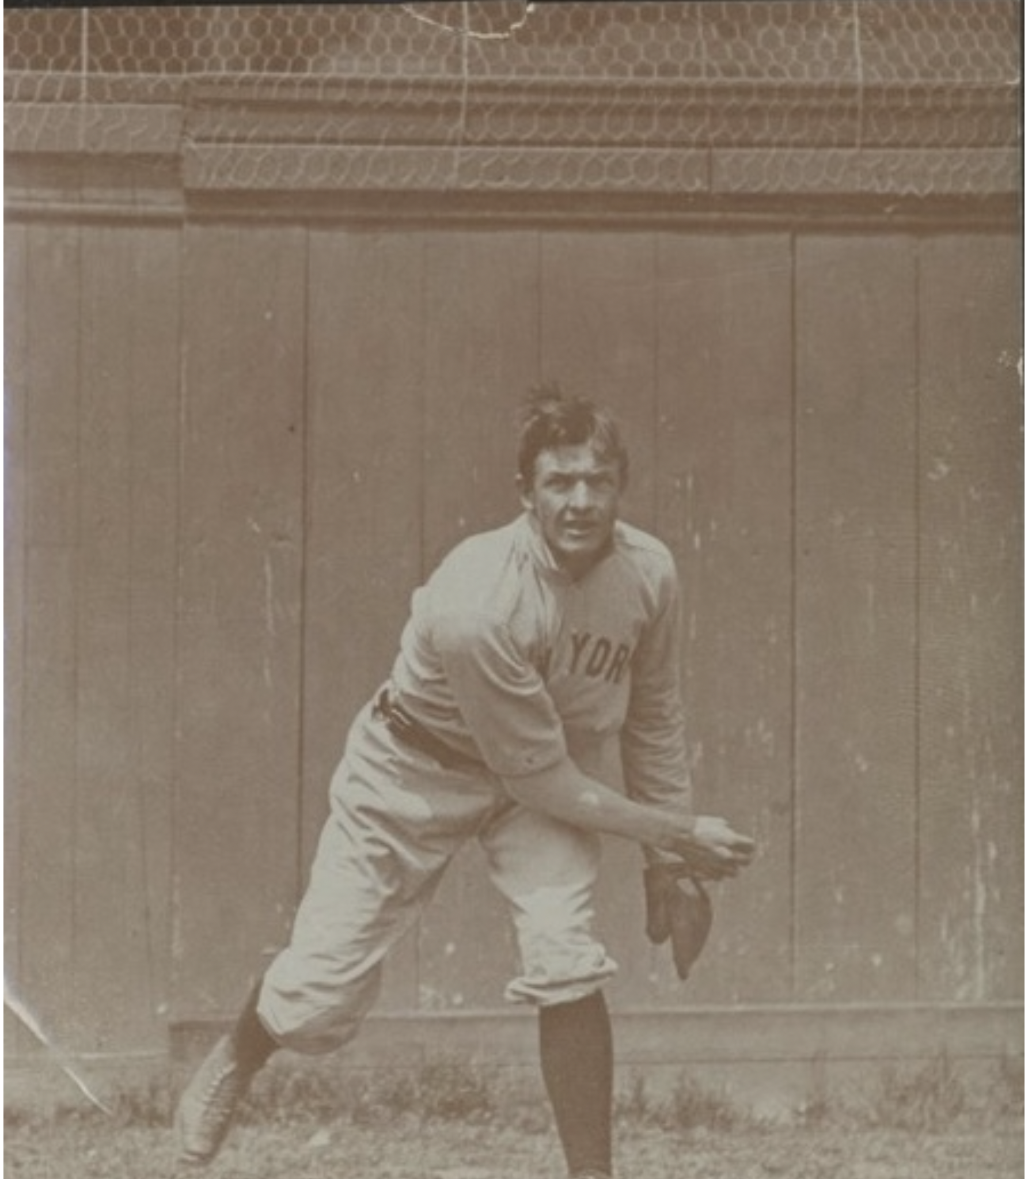

Slide 5
